Slide 1
Merlin’s Magical Musical Universe
‘Those who say it can’t be done shouldn’t
interrupt the people doing it’

Slide 2
Just another day at the office ☺

Slide 3
Sometimes outside the office

Slide 4
Work hard, play hard!

Slide 5
14 years ago
Important lessons for me
First bring something before expecting to receive something
Aim (unreachable) high
Enjoy what you do

Slide 6
Motivation in education
Find your inner desires
Make people happy
Be post-modern

Slide 7
Where did this lead to?
2009 Founding of Foundation for Dutch Music Export (SNME, Stichting Nederlandse Muziek Export)
2011 Start of cultural nightclub Subsonic in Groningen
2014 Resurrection of Simplon venue in Groningen
2015 Founding of the Subciety cultural overview platform

Slide 8
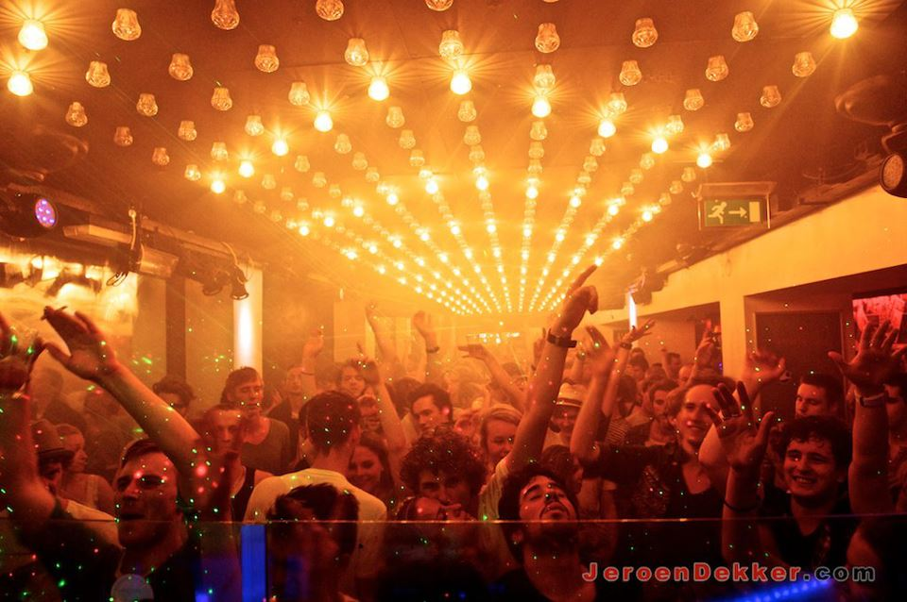

Slide 9
What are we aiming at?
Connecting varied open-minded people with different backgrounds and ambitious ideas
Creating a better environment for collaboration and communication in a city, first in Groningen later worldwide
Making it more common to share knowledge, network and money to reach these goals

Slide 10
How are we gonna achieve this?
Creating an easy accessible platform for people involved and interested in anything music-related, for both industry and consumers
Giving an overview of what is happening where on cultural base from small underground concepts to big events
Rewarding interaction in real life
Connecting succesfull artists with eager and ambitious ones

Slide 11
What is gonna be the result?
A worldwide network of cultural organisations, artists, venues and people interested in these entities
More talent-development
A ‘pay it forward’ principle without
an expected reward

Slide 12
So let’s connect, share and dream
See you in Subciety!

